Slide 1


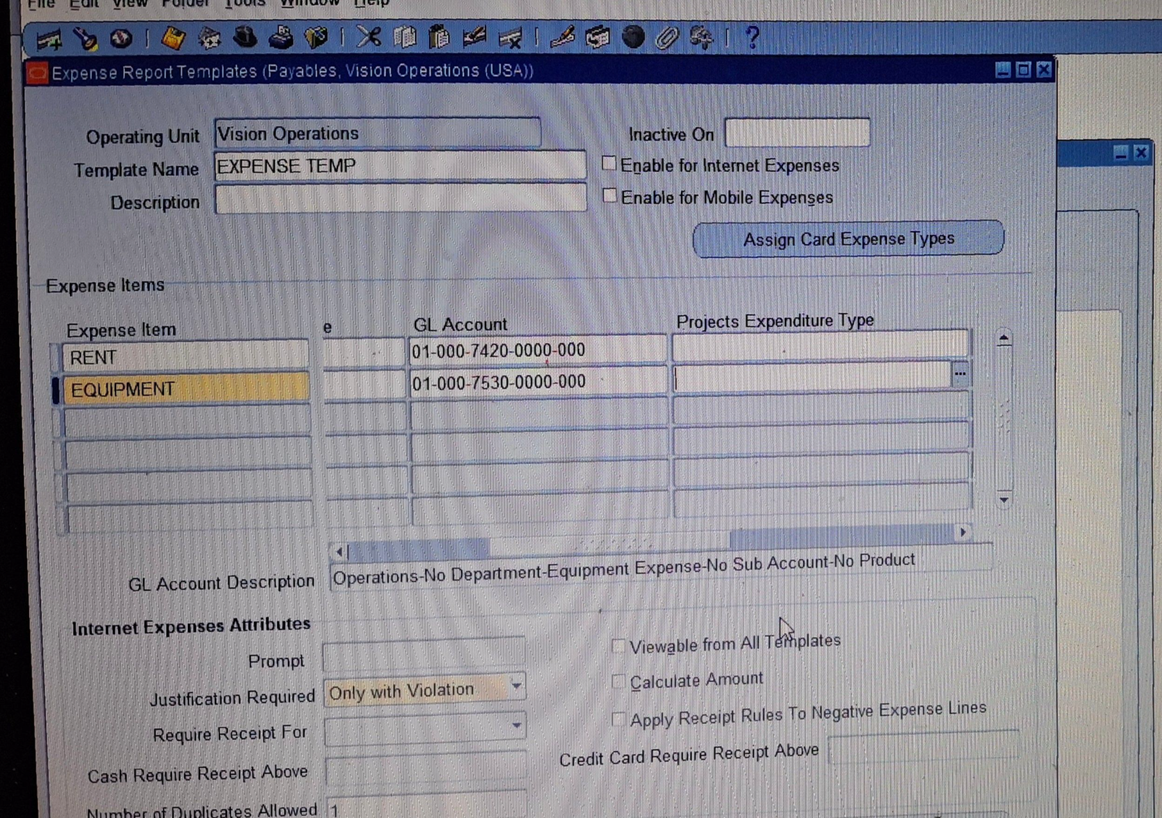
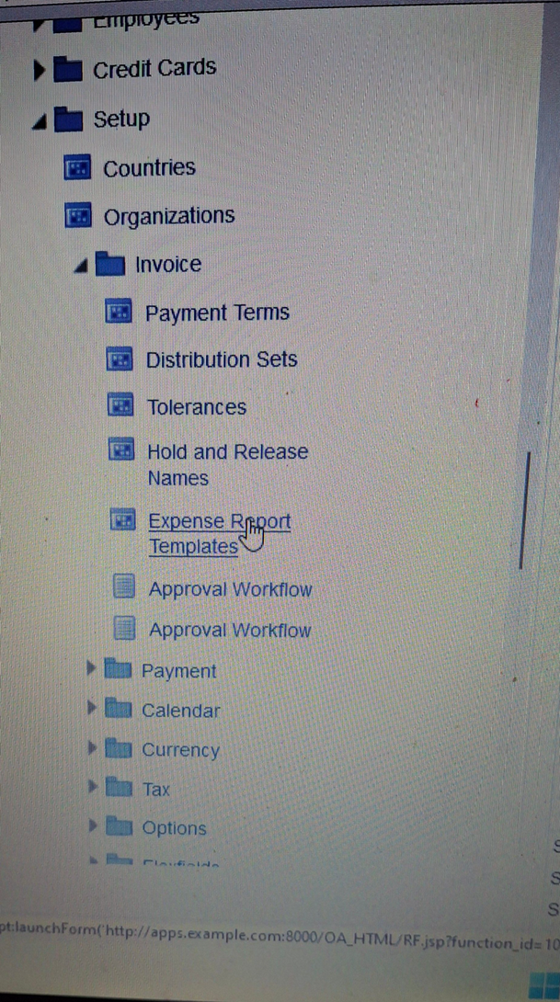
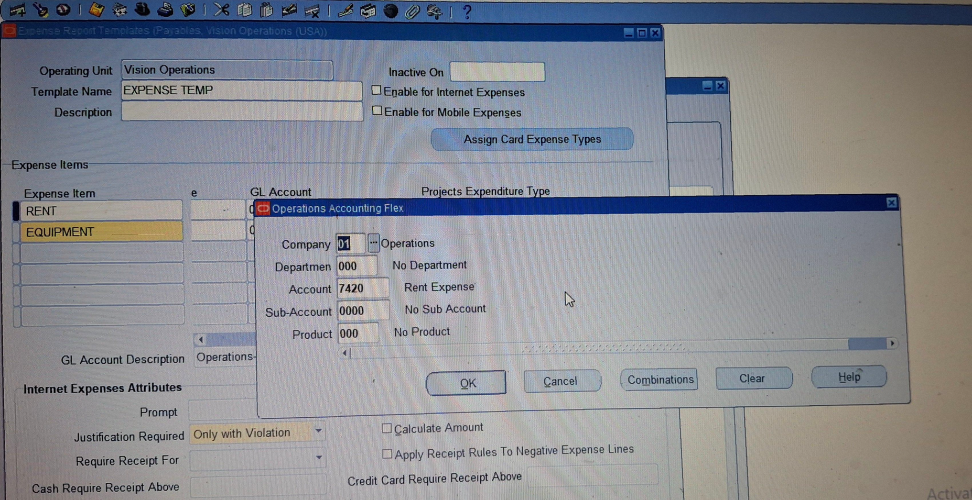
Create and Manage Supplier Invoices
Expense Report
Setup > Invoices > Expense Report Templates
Template Name ( EXPENSE TEMP)​
︎ EXPENSE Item ( Rent & Equipment )
Click OK then Save
24

Slide 2
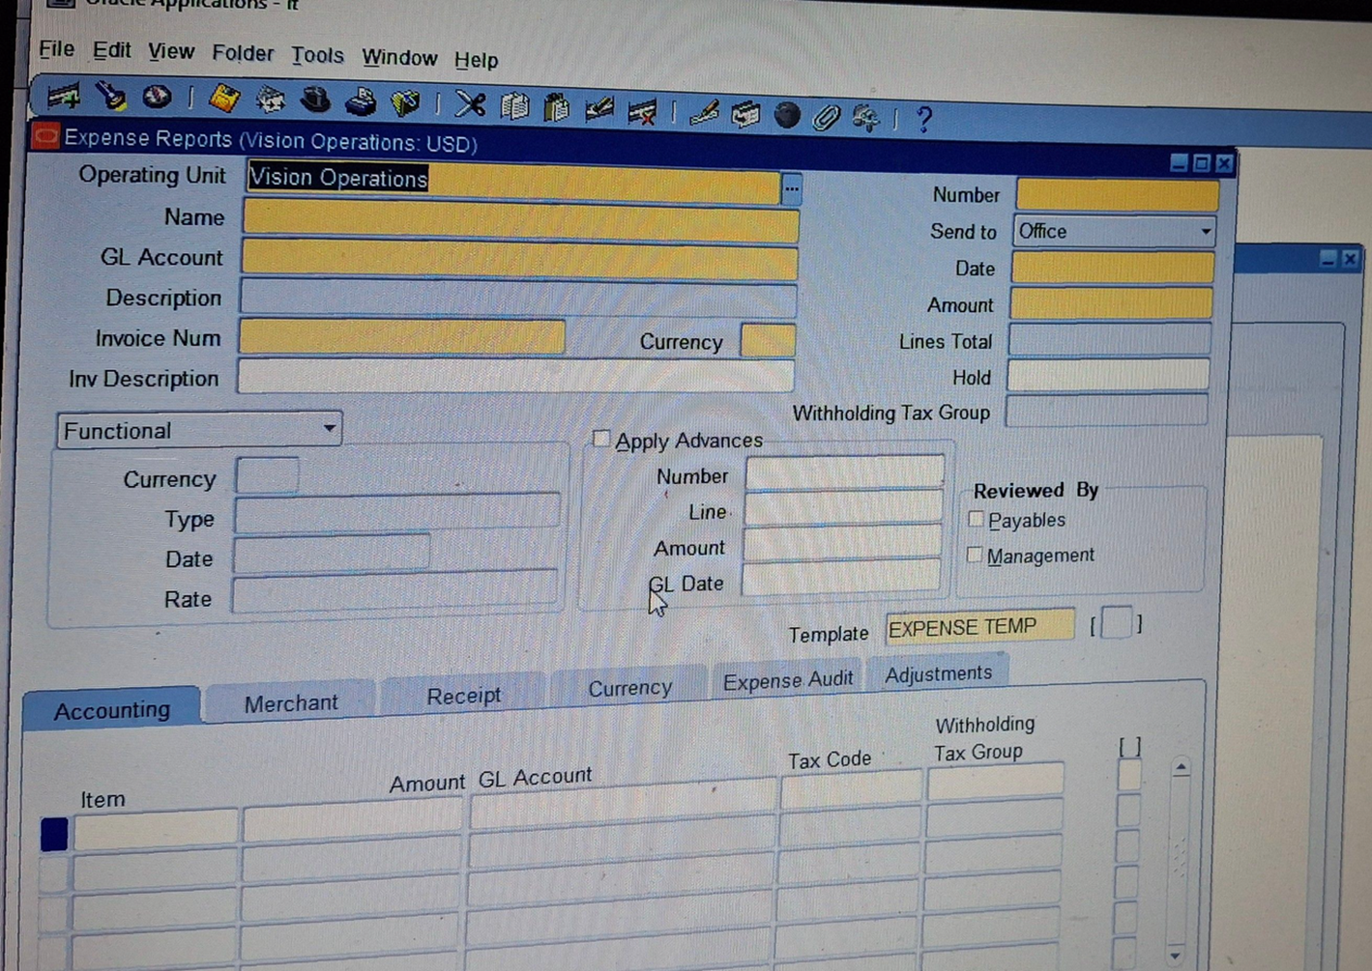
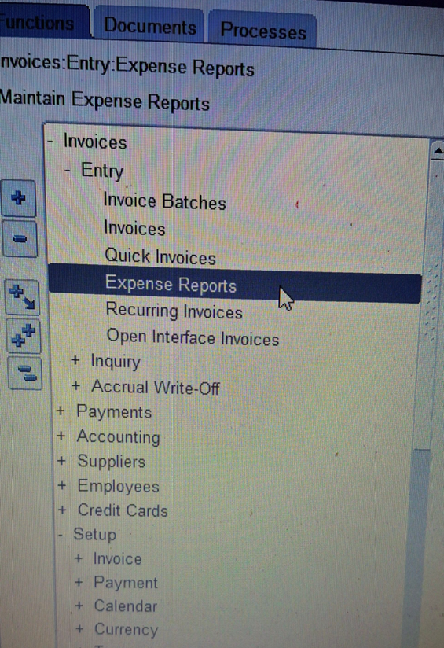
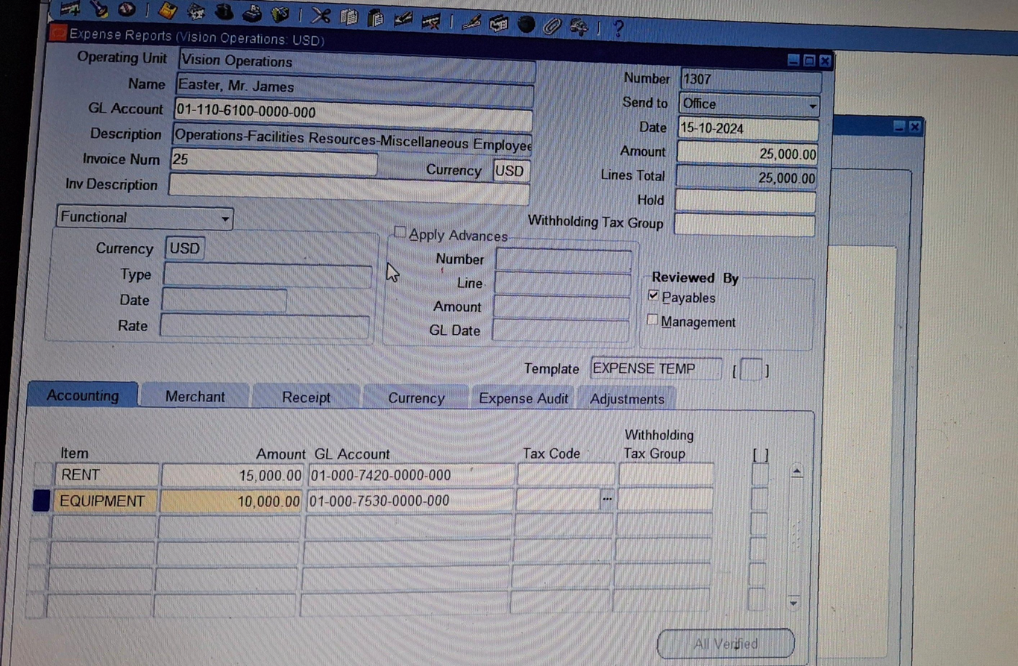
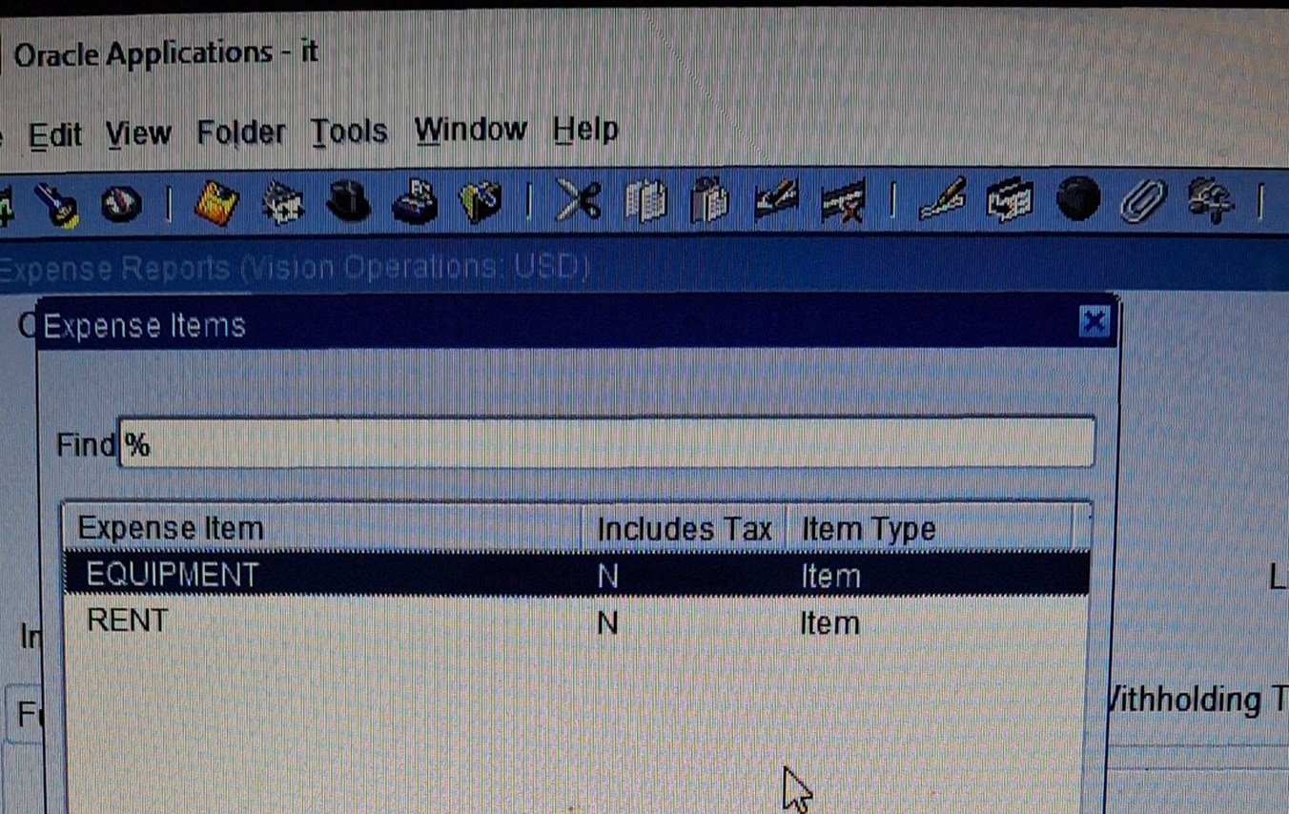
Create and Manage Supplier Invoices
Expense Report
Invoice > Entry > Expense Reports
Select Name and Gl Account then OK​
︎Select Date & Amount
︎ Accounting > item > Rent > Rent Exp> OK​
Accounting > item > Equipment > Equipment Exp > OK
25
Notes:
Note /The Amount Of Item Rent + EQUIPMENT Should be equal The Amount of Invoice

